Slide 1
DATA PREPROCESSING
IN DATA ANALYTICS

Slide 2
Preprocessing is the process of transforming raw data into an understandable format.
It is also an important step in Data Analytics as we cannot work with raw data.
The quality of the data should be checked before applying Analysis.

Slide 3
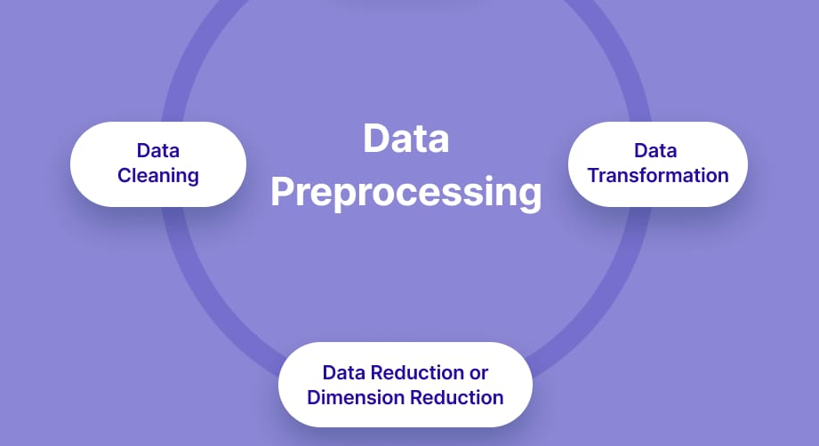
Three major steps in Data preprocessing

Slide 4
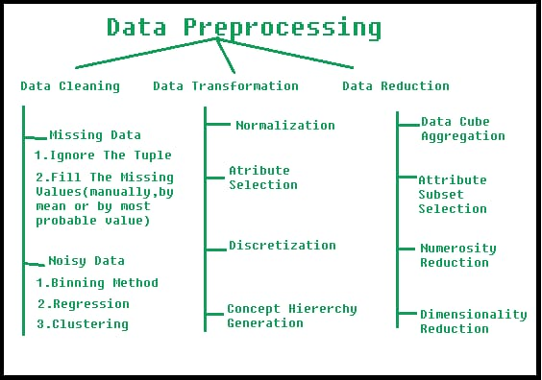

Slide 5
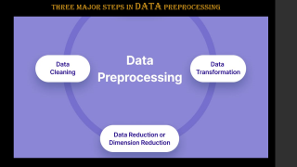
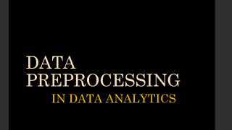
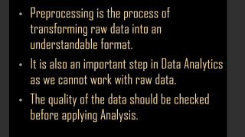
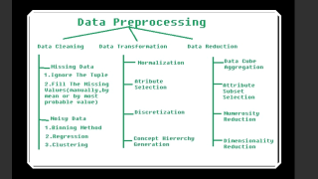
LET US LOOK INTO OUR PROJECT NOW.

